Slide 1
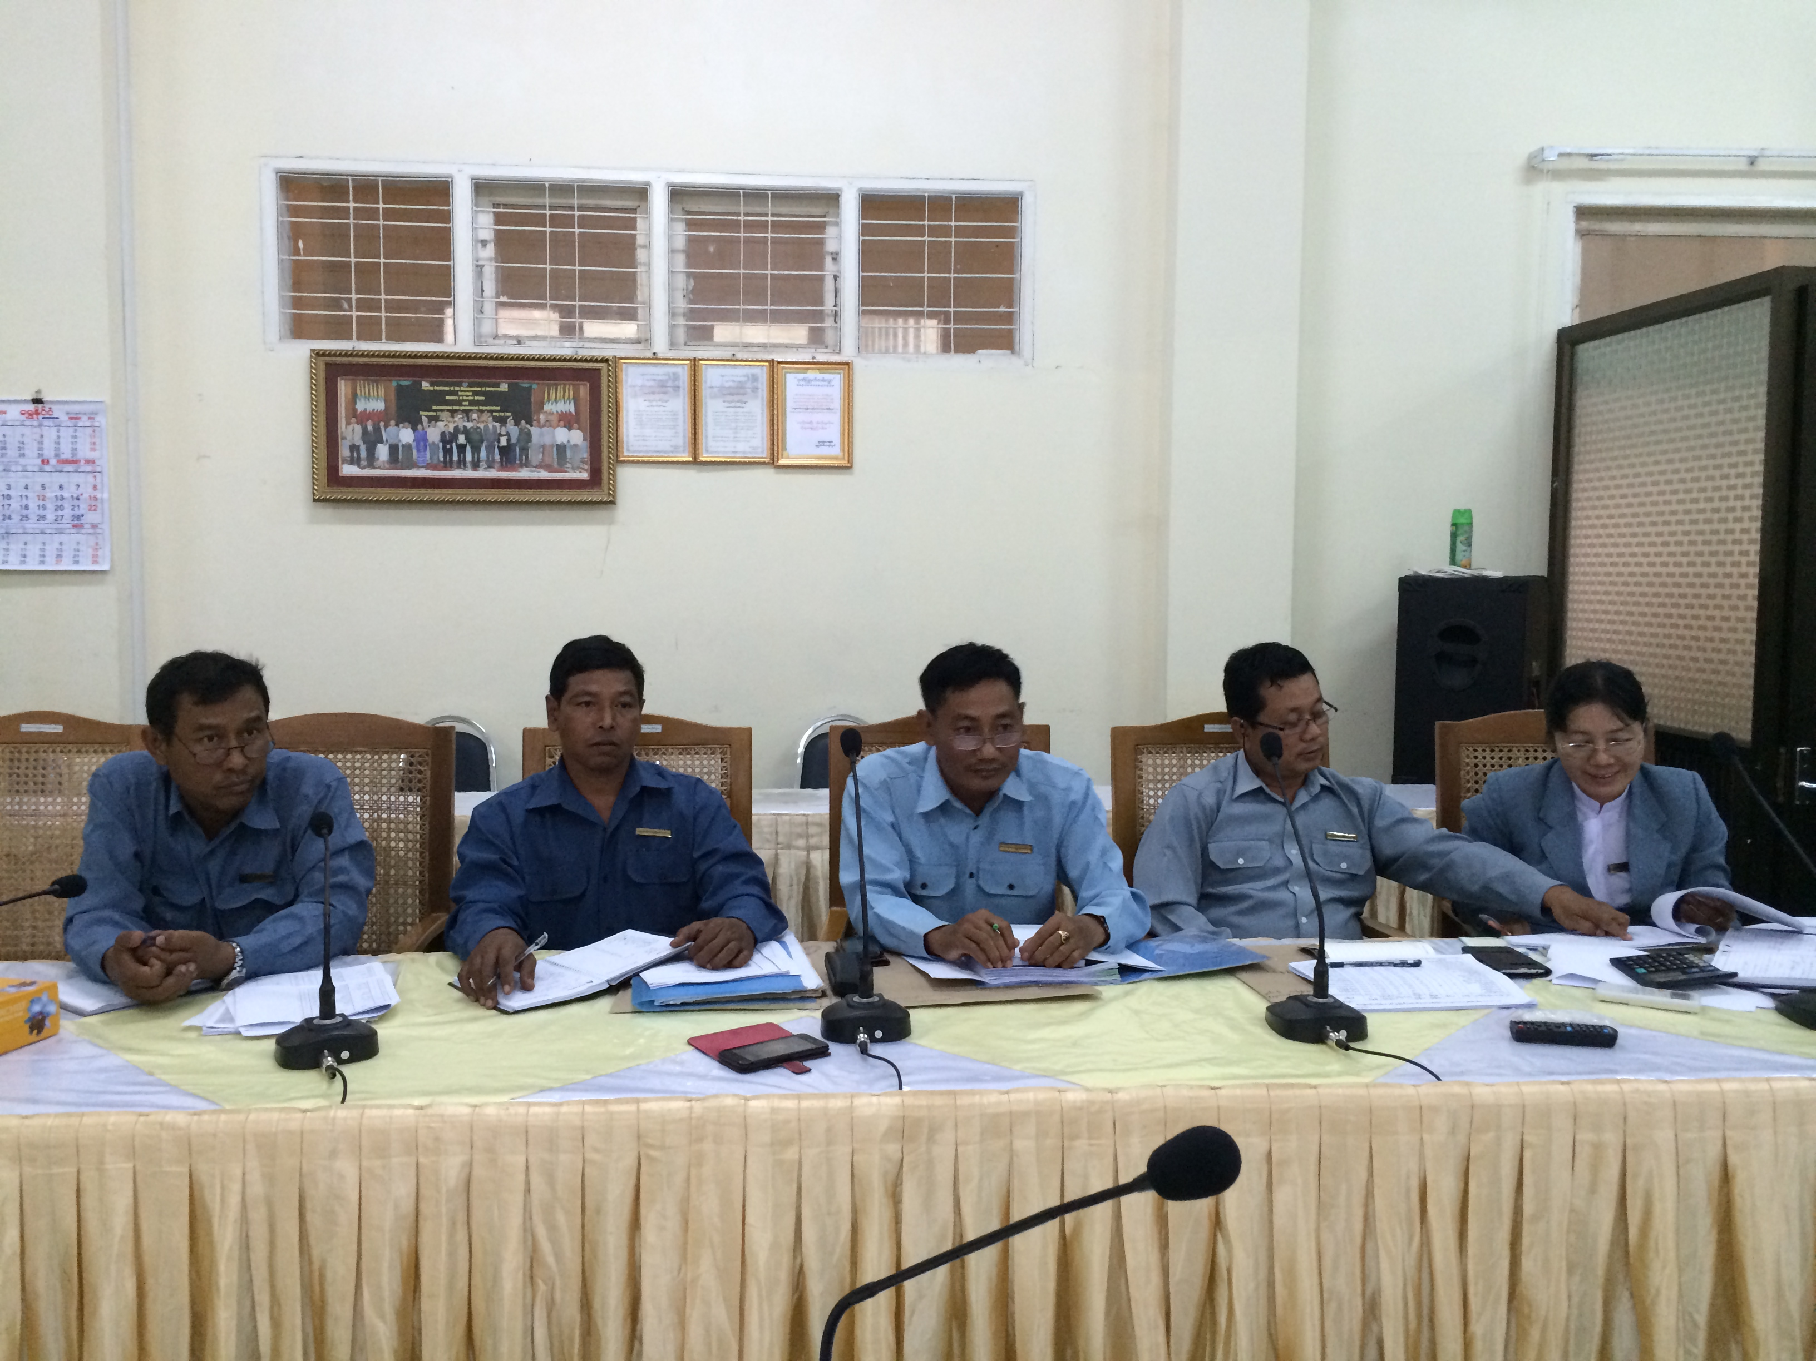
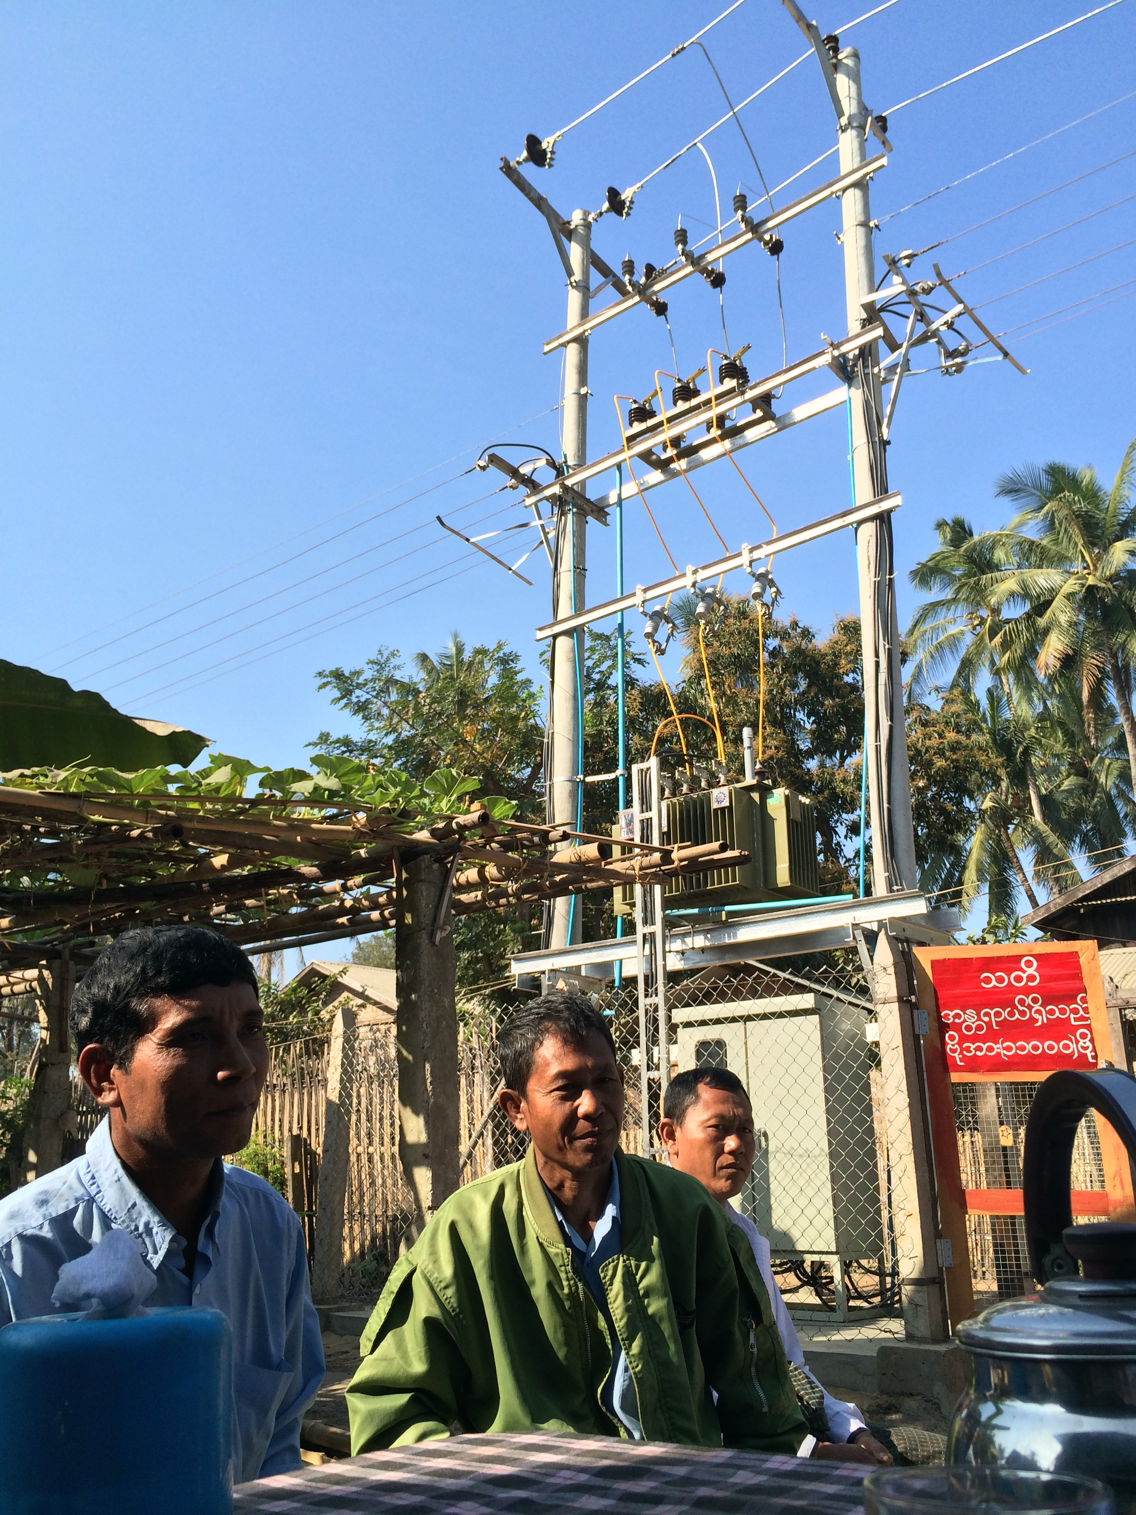

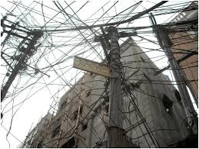
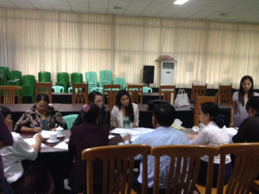
Implementation Road Map for National Electrification Program
Draft Final Recommendations
Alex Sundakov, September 2014

Slide 2
PRESENTATION Outline
Scale of Myanmar’s Electrification Challenge
Need for Institutional Strengthening and Reform
Recommendations for:
  Program-level Coordination
  Implementing Grid Connections in YESB Franchise Area
  Role of Private Sector
  Implementing Grid Connections in ESE Franchise Area
  Implementing Permanent and Temporary Mini-grids
  Implementing Household Level Off-grid Connections
Need for Donor-backed Technical Assistance

Slide 3
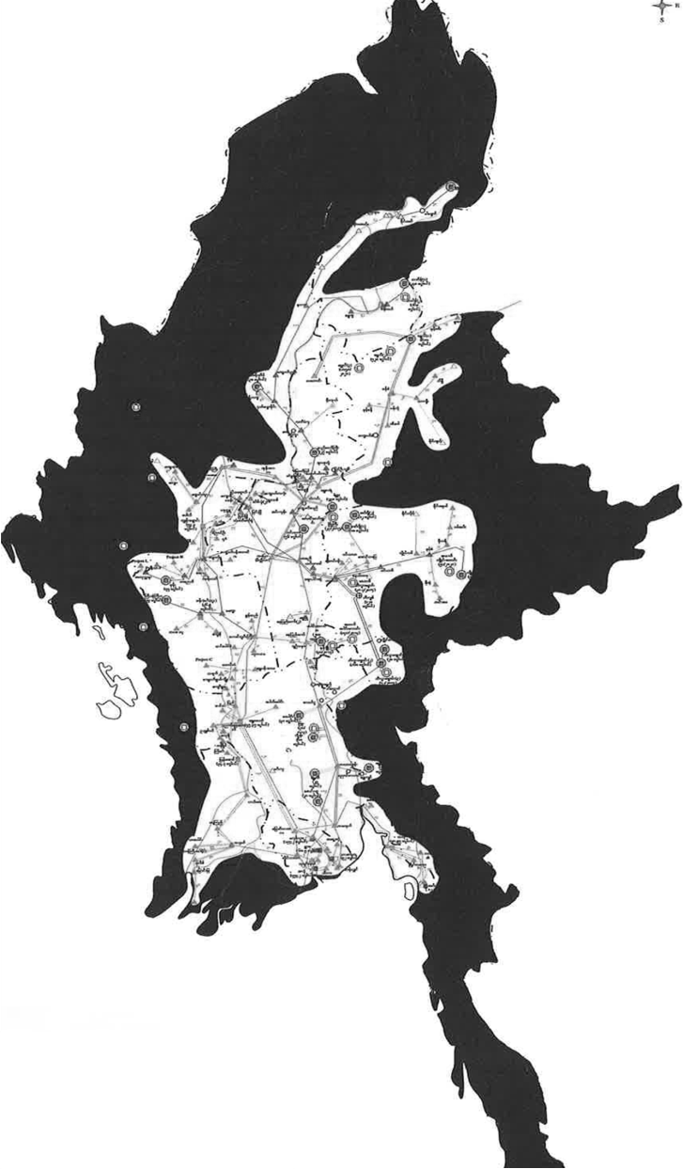
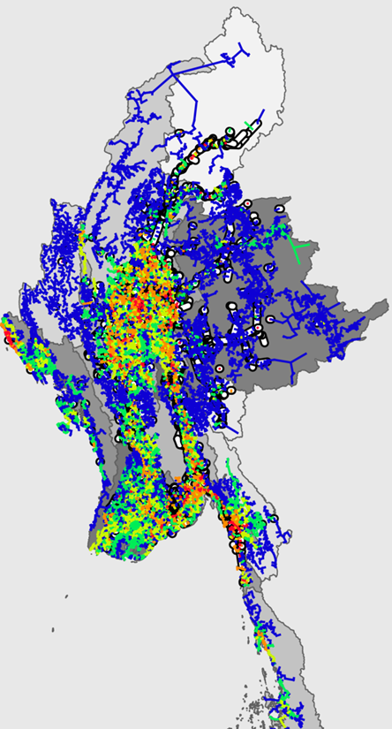
Myanmar’s electrification challenge is immense
The Earth Institute estimates that over 7.21 million new planned connections need to be made to achieve universal electrification by 2030…
Total Connections Needed by Type
Grid | 7,201,291
Permanent Mini Grid | 10,880
Off Grid | 4467
Total | 7,216,638
Source: Earth Institute
Majority of the new connections will be grid based by 2030
Source: MOEP
Source: Earth Institute
Today
2030 Planned

Slide 4

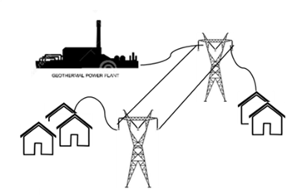

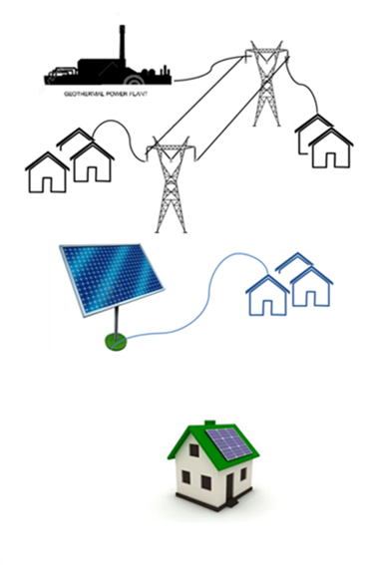

To meet this challenge, institutional strengthening is necessary
Strong Institutions would ensure…
Tariff from electricity sales
Union budget
Donor funding/ financing
There are sufficient funds and predictable financing flowing through the entire electrification program
Coordination and allocation of funding on sector-wide basis, based on plan
Funds flow to entities responsible for:
Project are being planned and prioritized in a least cost manner
National grid expansion
National grid
Projects are being built efficiently and are achieving social objectives
Temporary and Permanent Mini grid expansion
Household-level expansion (SHS)

Slide 5
The institutional reform will need to address barriers related to
Program-level management and coordination
Efficient operation of ESE and YESB under MOEP leadership, and ability to use private and community resources in sub-franchise areas
Accelerated implementation of mini-grids
Sustainability and efficiency of individual household-level solutions
Involving private sector efficiently

Slide 6
We have developed institutional recommendations for the following
1
Sector-wide Program level
Planning and Coordination
2
3
4
5
YESB Franchise Area Grid Connections
ESE Franchise Area Grid Connections
Mini-grid connections (includes pre-electrification)
Off grid Household-level Connections
5
Role of private sector
These recommendations are based on feedback from Government and recent decisions…

Slide 7
To ensure NEP is well planned and coordinated
Establish well-resourced Executive Secretariat reporting to the Office of the Vice President or President
Establish Independent Regulator for tariff & standard setting
Permanent Functions:
Maintain and update geospatial & financial plans for NEP
Monitor achievement of targets
Serve as main point of contact for development partners
Advise on management of coherent financing program
Provide advice and support to Ministries involved NEP program implementation.
Interim Functions:
Serve as acting regulator, until regulator formally established
Functions:
Review & update estimates of total funding requirement
Advise Govt on tariff options and implications for subsidy requirement
Coordinate timely delivery of required subsidy
Interim
Today (2015)
Medium Term

Slide 8


To accelerate connections efficiently in YESB franchise area
YESB needs to connect 207,000 new customers. To do this we recommend…
Short Term
Medium Term
Corporatize YESB, using IFC assistance
Develop Investment Program for YESB with IFC assistance
Enable YESB to access financing for distribution expansion. Executive Secretariat should:
Calculate appropriate cost of service for YESB, including cost of power purchases, and return on and of distribution capital
Determine how much of that cost will be recovered through tariffs
Provide balance through annual subsidy
Newly established Regulator (ER) should take over these functions from Secretariat
Country Case Studies
PUSO Subsidy to National Electricity Company (PLN)
State Govt. subsidies to DISCOs

Slide 9
ESE to follow same path as YESB…In addition, there are opportunities for private sector involvement in NEP implementation through sub-franchising
Electrification roll out program
Short term
Medium term
Create a mechanism to enable sub-franchises operators to access appropriate financing
Project A
MOEP
ES
Set tariffs
DPs
Banking Sector
ER
Implements connections
Sub-franchise operator
Private enterprise
Govt enterprise
PPP
Community enterprise
Customer Payments
Wheeling payments to ESE
Subsidy
Ensure ESE receives wheeling payments for its MV investments
MOEP
ES
Clear delineation of service areas and responsibilities
Competitively procured
Create a mechanism for delivering subsidies to operators where required
MOEP
ESE
ESE
MOEP
ER

Slide 10
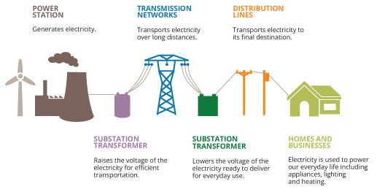
The basic structure of a sub-franchise concession
Constructs MV Lines (33 kVA and sometimes lower)
Maintains MV lines
Constructs substation with step-down transformer
ESE
Customers
Pay sub-franchise operator for electricity services
Sub Franchise Operator
Connects to ESE sub-station/transformer
Builds “last mile” low voltage lines (11kVA to 0.4 kVA)
Provides meter approved by MOEP
Operates and maintains line
Provides meter reading and revenue collection services

Slide 11

To implement mini-grids efficiently
The process for the implementation of mini-grids should broadly follow the process for sub-franchising of ESE grid areas:
  Decentralized “bottom-up” initiative but through standard processes
  Access to finance by developers via two-step loans through banks: on-lending of donor financing
  Least-cost subsidy mechanism
DRD should combine responsibility for household-level off grid systems with responsibility for mini-grids (both permanent and pre-electrification)

Slide 12
Recommended decentralized system for mini-grids adapted to Myanmar
Function | Who | What and How?
Funding and Financing Support | Union Govt Agency | Various mechanisms possible, from funding feasibility studies, to competitive subsidies to developers/VECs, to offering concessional loans to developers or a combination of all
Project Prioritization | Union Govt, with support from Regional Govt | Linked to priority areas, and electrification targets in each area, but primarily prioritized around the quality of project preparation at local level
Detailed Project Design | Private developers, or developers contracted by VECs | Need to follow the basic design and construction standards stipulated by the Union Government
Procurement of Materials, Construction | Private developers, VECs | Not necessary to follow a standard process
Processes, Guidelines and Standard Setting | Union Government Agency | Would provide light handed processes for applying for permits, and potentially regulation of service standards
Performance oversight | Regional Government or local community | If a loan has to be repaid, or a contract between the developer and central Government requires a specific tariff to be charged, may involve some degree of central oversight. If it is self-sustaining less oversight will be needed

Slide 13


To ensure efficient and sustainable household and community level electrification solutions
DRD should:
Provide financial incentives that promote cost-recovering business models to flourish
Provide clear guidelines for entities that will benefit from incentives
Encourage scaling up where SHS is economical
Provide training support/incentives for technicians
Closely monitor program’s progress
Bangladesh: IDCOL Model
Possible SHS Models to learn from:
Lao PDR: OGS-PESCO-VEM Model

Slide 14

Summary of institutional recommendations
Executive Secretariat reporting to VP Office
Overall management and coordination of geospatial plan
Performance reporting
Point source for donors
Donors
TA for establishing and training new entities
Concessional finance for entire program
Establish 2-step loan program with banks
Independent Regulator
Advise on tariffs, standards and subsidies needed
YESB Franchise Area
Develop Investment Program with IFC
Corporatize YESB
ESE Franchise Area
ESE to follow YESB path
Set up Sub-franchise concessions
Mini-grid Conns.
Decentralized but standard approach modeled along ESE sub franchise concessions
DRD manage & monitor
Off grid Conns
DRD manage & monitor
Re-orient program towards giving financial incentives rather than free SHS
Support private sector SHS provision
Under MOEP leadership
Private Sector
Participate in sub franchise concessions
SHS provision

Slide 15
Estimated requirement for technical assistance
Need assessed over the next 2 to 3 years….
Function | Person/Month | Rate | Cost
Setting up Executive Secretariat | 48 | $30,000 | $1,440,000
Detailed Implementation Plan | 62 | $30,000 | $1,860,000
Cost of Service Study | 24 | $30,000 | $720,000
Tariff Study | 18 | $30,000 | $540,000
Subsidy Design and Implementation | 36 | $30,000 | $1,080,000
YESB & ESE Planning and Financial Control | 36 | $30,000 | $1,080,000
YESB & ESE Procurement processes & strategies | 48 | $30,000 | $1,440,000
ESE Train the Trainer | 24 | $30,000 | $720,000
Bank Lending Policies and Credit Assessment | 42 | $30,000 | $1,260,000
 |  | Total | $10,440,000

Slide 16
Recommended next steps
Government of Myanmar formally adopts the Roadmap, including the institutional implementation plan via Government Decree
Government appoints an Executive Secretariat (ES) tasked with coordinating roll-out program and responsible directly to the Vice-President.
ES empowered by Decree to act as single window for cooperation with Myanmar’s development partners in relation to NEP.
While various agencies involved in the roll-out (such as the Myanmar International Cooperation Agency being set up by MLFRD as an implementation enterprise) will have direct dealings with donors, ES coordinates the overall financing, helping aligning donor preferences with the responsibilities of particular agencies
1
2

Slide 17
Recommended next steps
3
Government initiates a DP coordination and pledging process, and continues working with donors to secure the full financing package needed for program implementation
Government formally and publically instructs ES to conduct a tariff study (with appropriate technical assistance), and to conduct public consultation to improve public understanding of the costs of the electricity service and of the required tariff decisions
Government appoints advisors to develop a sub-franchising mechanism and standard documentation to facilitate private sector participation in the roll-out program
Government makes short-term changes to the budgeting process for YESB and ESE to facilitate more independent commercial decision-making and to encourage and enable both to borrow on their balance sheet.
4
5
6

Slide 18
Contact us
Alex Sundakov
36-38 Young Street
Sydney, NSW 2000
Australia
Alex.Sundakov@castalia-advisors.com
www.castalia-advisors.com

